Slide 1

0➔1➔∞
Guessenger with AWS


Slide 2
Agenda
Guessenger Status
AWS Services
Success Story
AWS Global Infrastructure
Global Structure for Guessenger with AWS
Log and Stream Analysis
Cost and Benefits
Why Cloud

Slide 3


Guessenger Status
What is Guessenger
Nearby social network; Message, photos and videos; Mobile devices, laptops, and web
User Base
US and Europe
Host Location
Middle of US
Human Resource
6 developers and 4 supporters
Business Prospect
Advertising Revenue
User Trend
Users increase to 20m from 3m within the coming 12 months
Business

Slide 4

Current Host Structure
6000$/M
Web/App Server:
14*(2 cores*4GB*500GB)
DB Server:
1*(4 cores*16GB*200GB)
Disk/Storage:
Users file storage: 12*500GB≈6TB
Log storage: 2*500GB≈1TB
Web Server merged together with App server
No Loading Balance
No backup at all
Low Resource Utilization
No Firewall
Cannot handle Asia market
Upfront pay
Akamai CDN
4000$/M
Salary*4
App
Web
Akamai: 20TB/m
Admins: 4
DB
Log Info

Slide 5
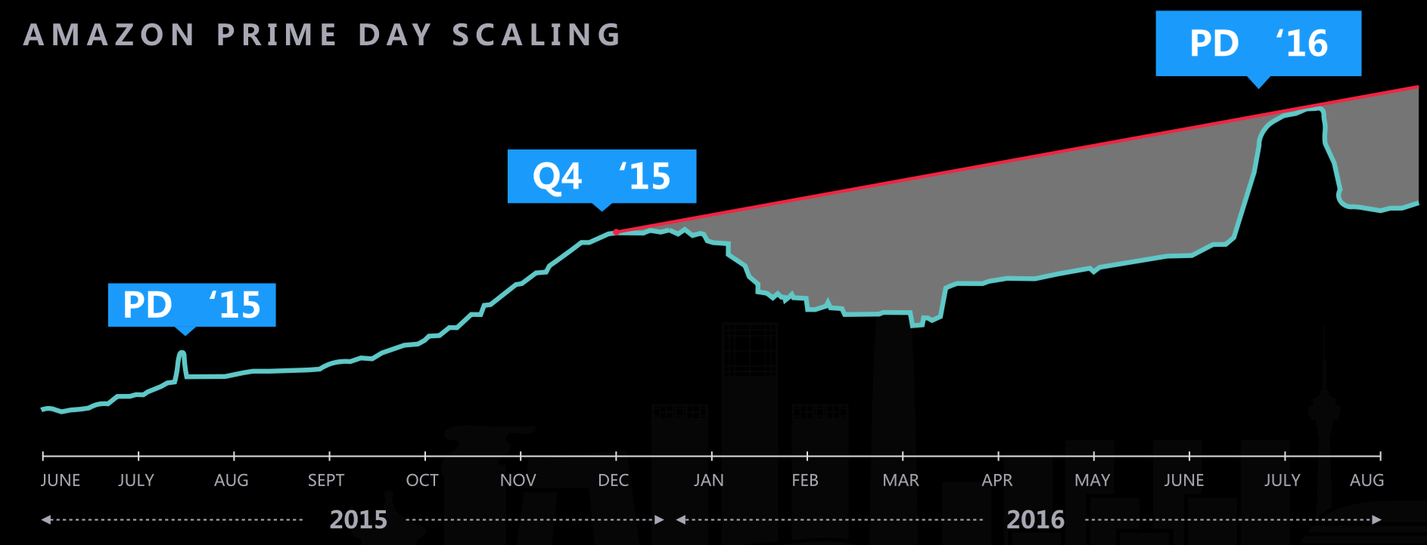
Why Cloud

Slide 6
Success Stories with AWS
AWS 云的弹性和在几分钟内预配置服务器的能力使奇虎 360 可以显著提高对海外市场的变化作出反应的速度。
谭晓生
360副总裁
By using services such as ELB, SQS, EC2, RDS, Auto Scaling, Elastic Cache, CloudTrail, Siemens has built a secure, and scalable platform on AWS.
Migrate nearly all of its cloud computing functions to AWS because of service administration challenges experienced with its original provider.
Using 200 EC2 instances. Can easily process and analyze 50 Gigabytes of data daily with EMR. Amazon S3 to save 10 terabytes of user pictures.

Slide 7
Internet Users Distribution
Current Market
Biggest Market

Slide 8
AWS Regions in the World

Slide 9





Geussgener Structure in the World
US
Europe
China
India
Route 53
US
Europe
China
India

Slide 10
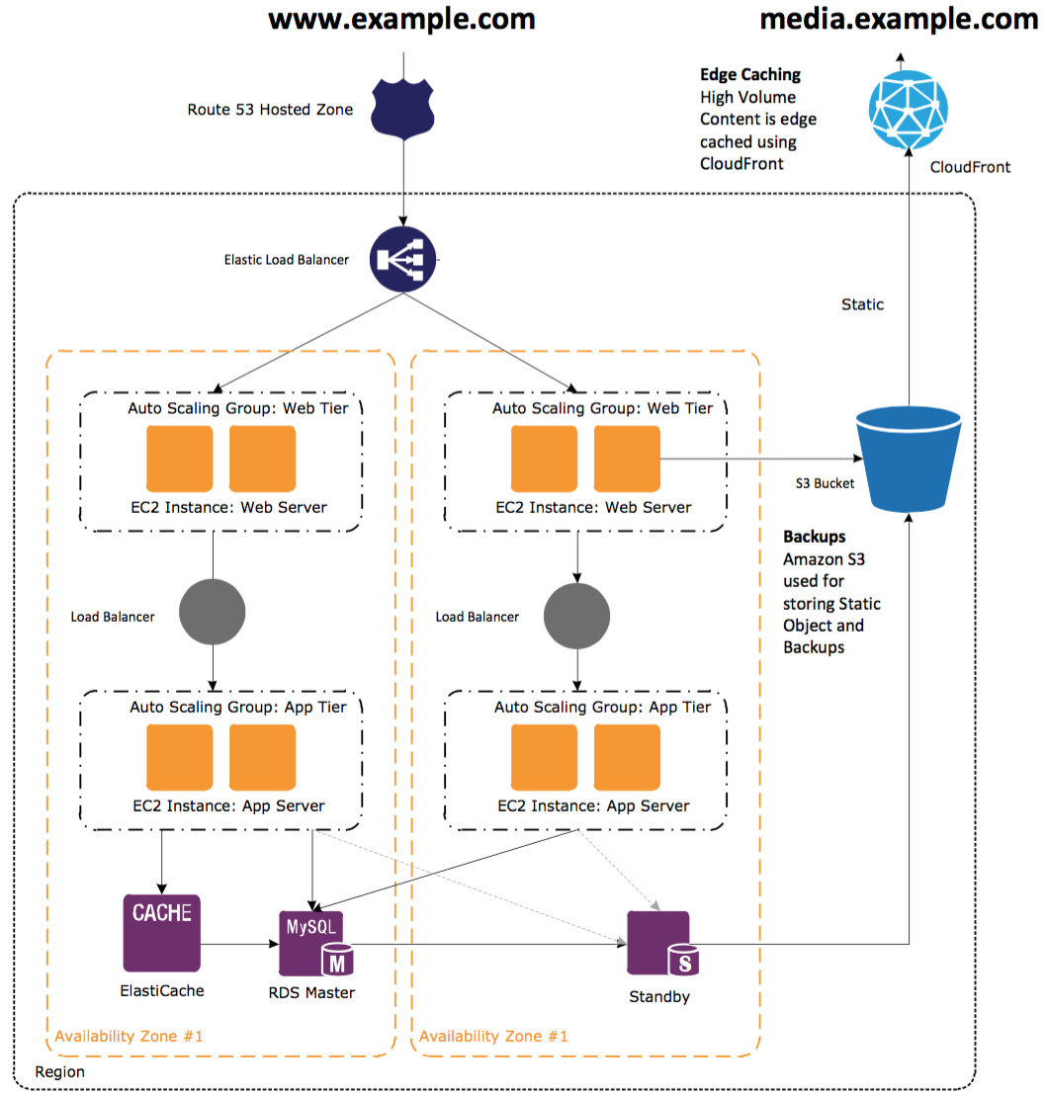



Global Service
Multi-routing polices
Health Check and Failover
Route 53
Global Service
Static/Dynamic Acceleration
CloudFront
Web Storage
Object, High Availability
S3

Slide 11
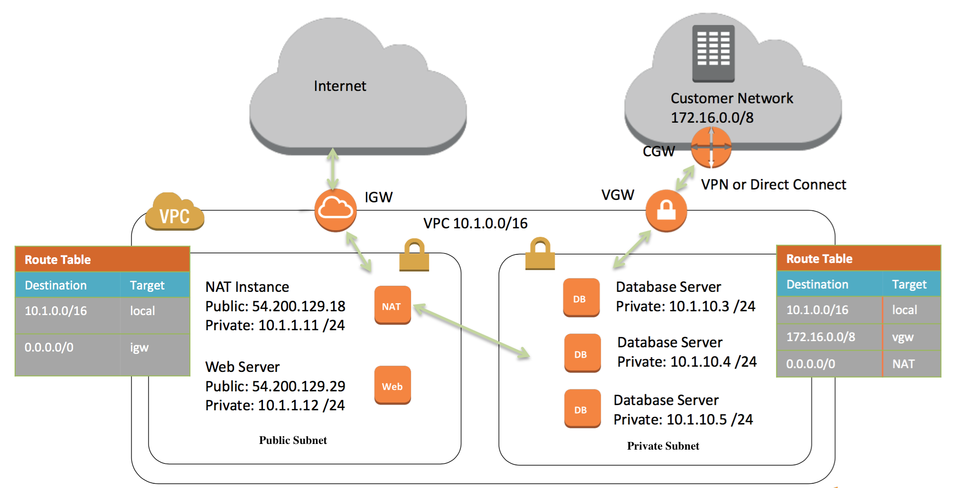
Connect to Internet and Data Center

Slide 12
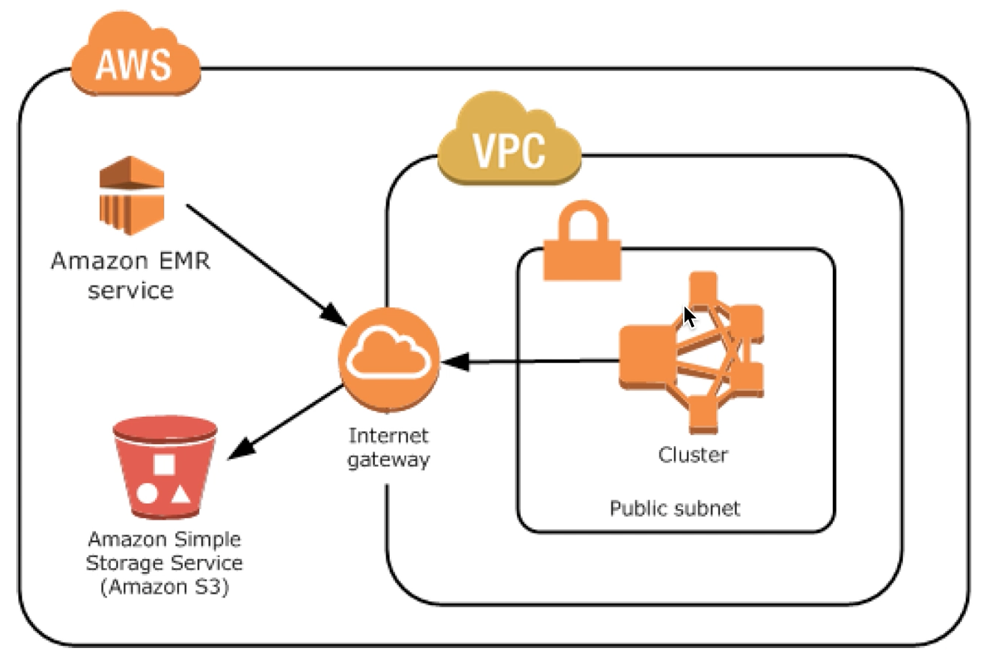
Log Analysis with EMR
Master Node
YARN RM, HDFS NN
Core Node
HDFS DN, Calculation
Task Node
Calculation
On Demand
8*10 Hours
On Demand + Spot
8*5 Hours
8*5 Hours

Slide 13
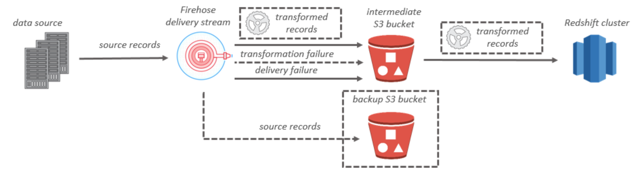
Log Analysis with Kinesis and Redshift
Setup redshift cluster and create db and tables
Create delivery stream and use Lambda transform records(apache log 2 CSV)
Put data to delivery stream
Query and analyze from Redshift

Slide 14
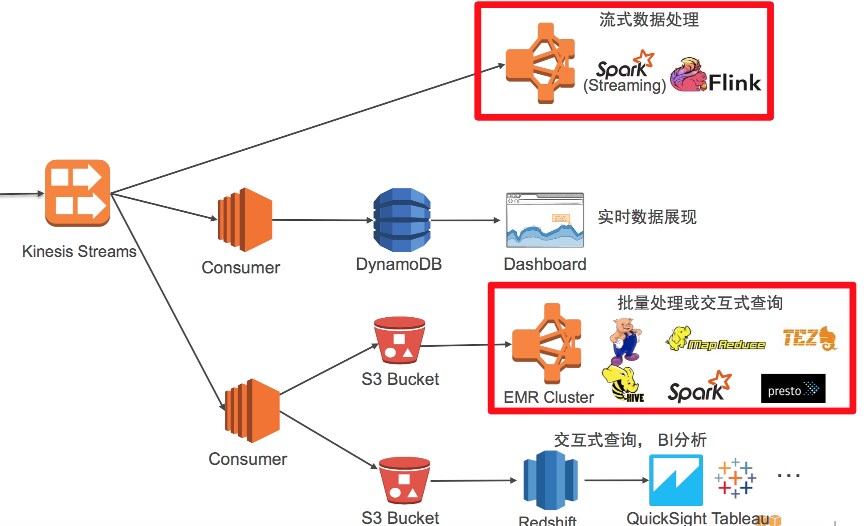

Stream Analysis

Slide 15
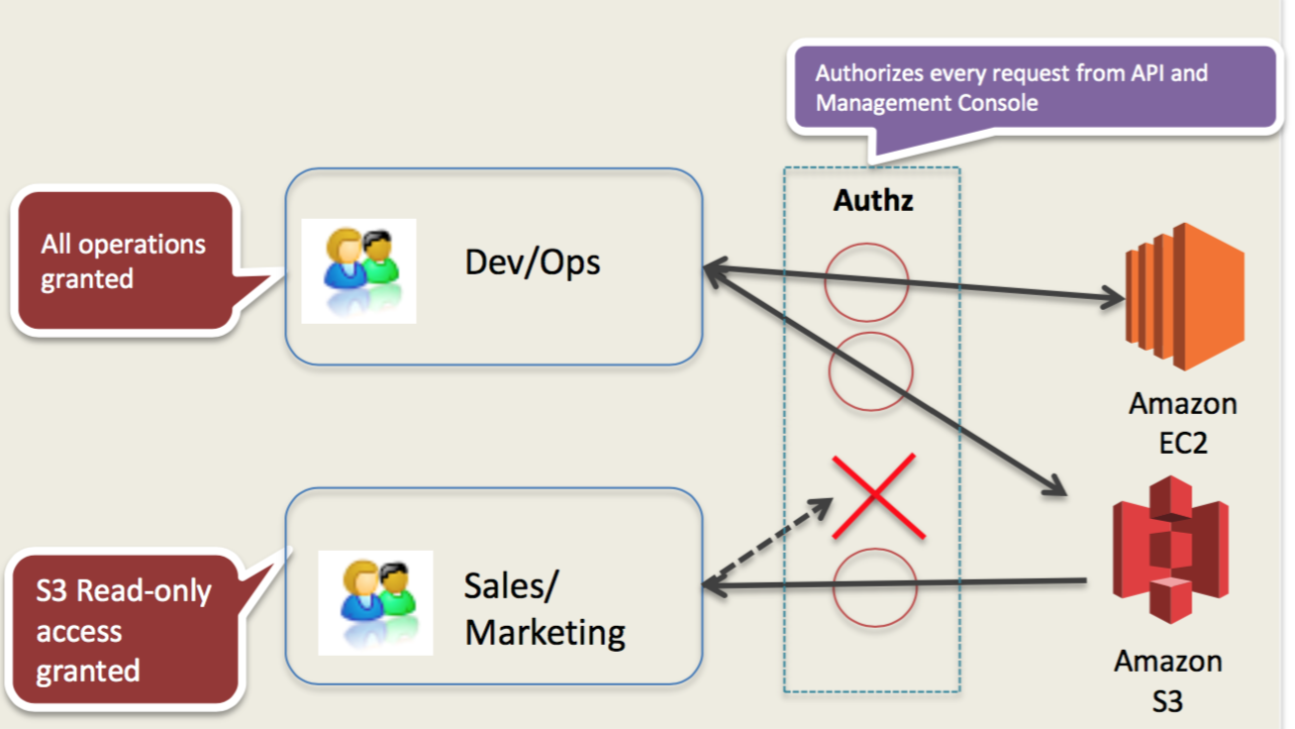
Permission and Security Control

Slide 16
Web/App Server Cost
 | Hour Cost | Month Cost | Year Cost | 3 Year Cost | Pay Style
Linux on t2.medium 1 instance (2 CPU, 4GB MEM) | 0.061 | 44.66 | 535.92 | 1607.76 | On Demand
 | 0.045 | 32.49 | 389.88 | 1169.64 | NUR/1 Year
 | 0.042 | 30.67 | 367.96 | 1103.88 | PUR/1 Year
 | 0.041 | 30.09 | 361.00 | 1083.00 | AUR/1 Year
NUR: Non Upfront Reserved; PUR: Partial Upfront Reserved; AUR: All Upfront Reserved
14 Instance * 44.66/M=625.24$/M
14 Instance * 32.49/M=454.86$/M
14 Instance * 30.67/M=429.38$/M
14 Instance * 30.09/M=421.26$/M

Slide 17
Cost of Cloudfront Route53 ELB EBS
Table 1. Cloudfront configuration and price
 | Month Volume | Cost $/M
CloudFront | 20TB | 4608
Table 2. Route53 configuration and price
 | GeoloctionBased Routing Queries | Cost $/M
Route 53 | 30Million/Day | 549
Table 3. ELB configuration and price
 | No. | Total Data Processed by all ELBs | Cost $/M
ELB | 3*4=12 | 20TB/M | 491.78
Table 4. EBS configuration and price
 | Storage | IOPS | Throughput | Cost $/M
General Purpose SSD EBS | 14*16GB | 100 | 128GB/s | 376.32

Slide 18
Cost of EBS S3 DB Elasticache EMR
Table 5. S3 configuration and price
 | Storage | Cost $/M
S3 | 18TB | 479.24
Table 6. DB server configuration and price
 | Usage | DB engine | Deployment | Storage | Backup | Cost $/M
db.m4.4xlarge 1 instance (4 CPU, 16GB) | 24hours/D | MYSQL | Single-Zone | GP SSD 200GB | Standard 200GB | 1242.69
Table 7. Elastic Cache configuration and price
 | No. | Type | Cost $/M
Elastic Cache | 4 | cache.t2.medium | 257.68
Table 8. EMR configuration and price
 | No. | Type | Cost $/M
Elastic Cache | 4 | m1.small | 169.84

Slide 19
Cost Summary
Totally, 8629.41$/M
Cloudfront >50%

Slide 20
What Benefits We Get from AWS
CURRENT | AWS
14 Web/App Servers | 14 Web/App Servers, Auto-Scaling
Akamai | Cloudfront
6TB Storage | 18TB Storage
1 VPC | 4 VPCs
4 Support Engineers | 2 Support Engineers
1 DB Server | 1 DB Server, 1 Backup DB Server
X | IAM, ACL, and SG
X | 12 ELBs
X | 1 Geolocation based Route 53
X | 4 core Elasticache
X | 4 instance based EMR
10000$/M | 8629.41$/M (Save 13.71%)

Slide 21

Cooperate 2 Win-Win
That’s Why AWS

